Slide 1
Connecting the Dots between Amazon E-Book Reviews and Star Ratings
–An NLP Analysis Approach
Final Project for QMSS GR5067
Melissa Feeney, Connor Song, Mengting Wang, Xingchen Li, and Danielle Murad Waiss
Columbia University

Slide 2
Agenda
Introduction
Data Wrangling
Sentiment Analysis
Topic Modeling
Conclusions

Slide 3
Introduction
Research questions:
Can we use classification models on sentiment scores to predict star ratings?
What is the correlation between the polarity of reviews and star ratings?
Can topic probabilities and custom embeddings be used together to predict review rating category (positive, neutral, negative)?
Can we deduct meaningful genre categories from book titles and use them to assess whether specific book types are rated better?
Our hypotheses are:
The sentiment scores of reviews can be used to predict star ratings.
There is a positive relationship between polarity of reviews and star ratings.
The probability of each review containing each topic, along with embeddings to describe each review, will be strong predictors of review rating, as evidenced by strong model performance.
There is a relationship between book genres and the star ratings they received. Not all book genres will have the same star review distribution.

Slide 4
Data Wrangling
Used the “standard” pipeline we have seen in our class
Added review categories (Positive, Neutral, and Negative)
Clean Corpus
Tokenization
Remove Stop-Words
(len < 3)
Lemmatize
Embedding
For Embeddings, we used Word2Vec
Conduct a t-SNE dimension deduction analysis to explore our data

Slide 5
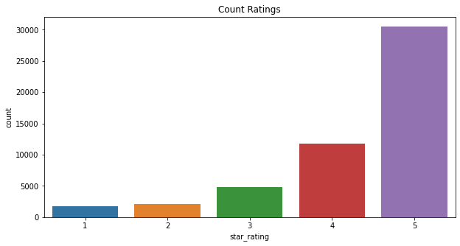
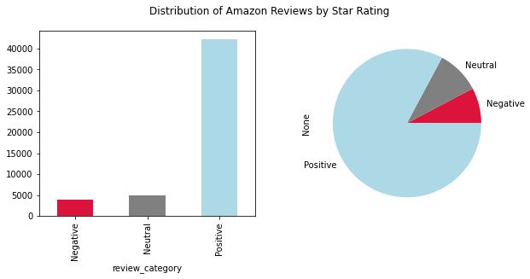
Data Descriptions
Star ratings counts
Distribution of reviews by star rating

Slide 6
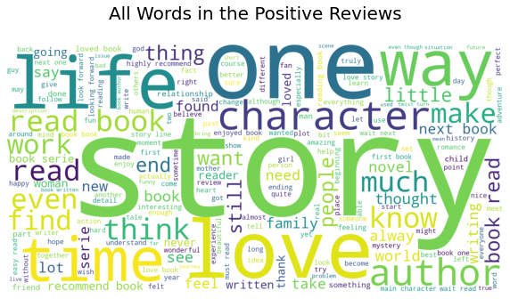
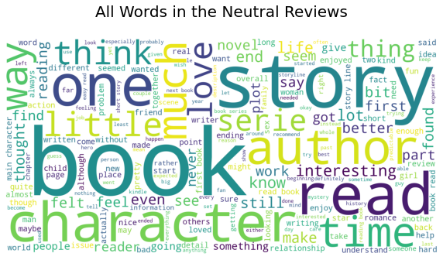
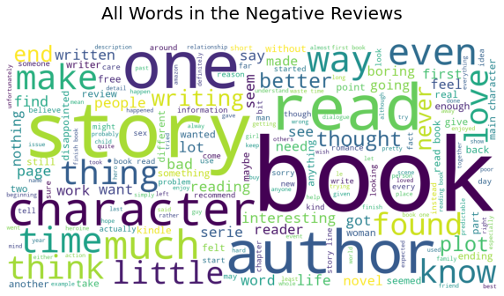
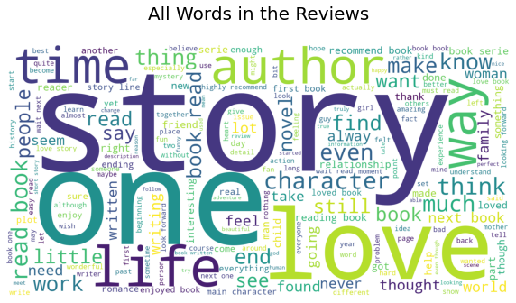
Wordcloud Visualizations
Word Cloud for Positive Reviews
Word Cloud for Neutral Reviews
Positive: 4~5 star
Neutral: 3 star
Negative: 1~2 star
Word Cloud for Negative Reviews
Word Cloud for all Reviews

Slide 7
t-SNE
Limitation of PCA
Complex non-linear relation
Sparseness of the matrix
May not present the geometric structure we intend to show (nearly impossible to keep points that are similar close to each other)
t-distributed Stochastic Neighbor Embedding
Convert high-dimensional Euclidean distance into conditional probability (where natural language may be a natural fit)
An improved method of SNE
Capable of Capturing the local structure while maintaining the global structure

Slide 8
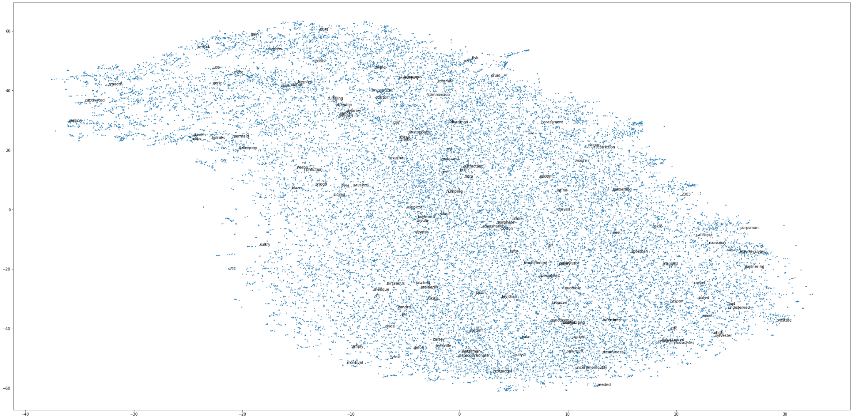
28,095 points with an original dimension of 100

Slide 9
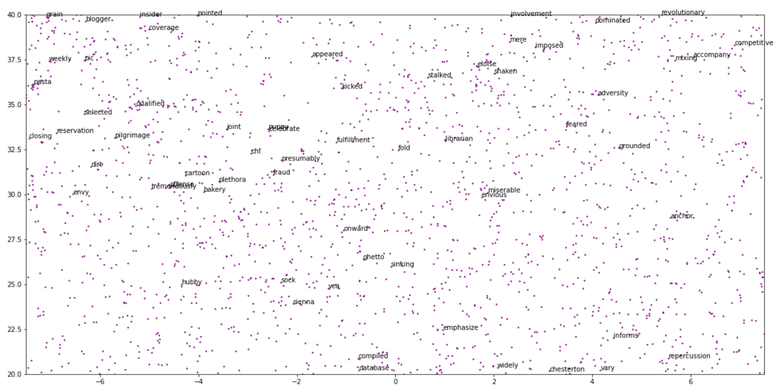
Zoomed-in Picture in the 2-D space

Slide 10
Sentiment Analysis Methods
Bert
Vader
TextBlob
Bidirectional Encoder Representations from Transformers
Pre-trained NLP model developed by Google in 2018
Being considered to be the most interesting model to work in deep learning NLP
Pre-trained on 2,500 million internet words and 800 million words of Book Corpus
Leverages a transformer-based architecture that can perform at a SOTA level
Valence Aware Dictionary and Sentiment Reasoner
Lexicon and rule-based sentiment analysis tool that is specifically attuned to sentiments in social media
A sentiment lexicon is a list of lexical features (e.g., words) which are generally labeled according to their semantic orientation as either positive or negative.
VADER also tells us the scores about how positive or negative a sentiment is
An open-source python library for processing textual data
Offers a simple API to access its methods and perform basic NLP tasks
Performs operations such as noun phrase extraction, sentiment analysis, classification, translation, etc

Slide 11
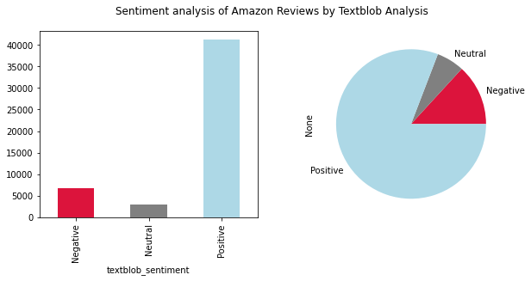
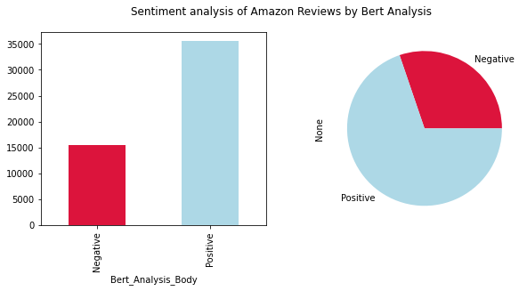
Sentiment Analysis Distributions
Textblob Analysis
Bert Analysis
Positive, Neutral, Negative:
(41230, 3052, 6735)
Positive, Neutral, Negative:
(35596, 0, 1542)
Baseline for Star Ratings- Positive, Neutral, Negative: (42252, 4830, 3935)

Slide 12
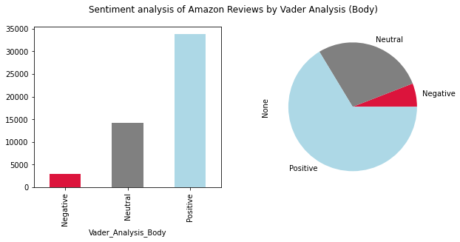
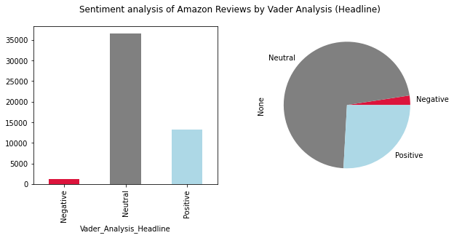
Sentiment Analysis Distributions
Vader Analysis (Reviews)
Vader Analysis (Headlines)
Positive, Neutral, Negative:
(33844, 14168, 3005)
Positive, Neutral, Negative:
(13206, 36576, 1235)
Baseline for Star Ratings- Positive, Neutral, Negative: (42252, 4830, 3935)

Slide 13
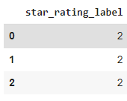
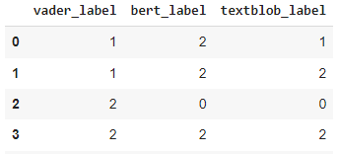
Classification Prediction using Sentiment Scores
Classification Models with Text Sentiment Analysis to Predict Star Ratings
Label for star ratings and different sentiment categories:
Y: Star ratings:
Positive: 4~5 <- 2
Neutral: 3 <- 1
Negative: 1~2 <- 0
X: Sentiment Labels (textblob, vader and bert):
Positive <- 2
Neutral <- 1
Negative <- 0
Imbalance target: SMOTE (Synthetic Minority Oversampling Technique)
We noticed that we got a lot of positive sentiments compared to negative and neutral. So it is crucial to balanced the classes in such situation.
I used SMOTE to balance out the problem and balance class distribution by randomly increasing minority class examples by replicating them.

Slide 14
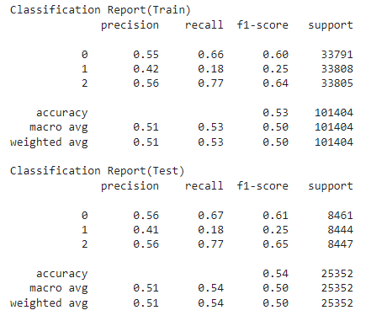
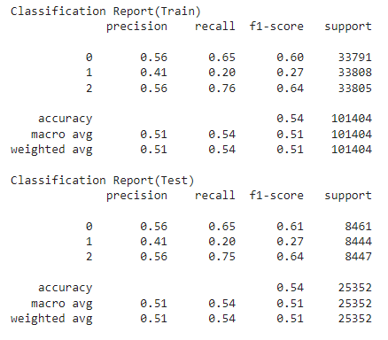
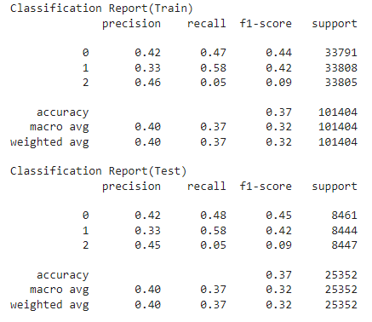
Classification Prediction using Sentiment Scores
Logistic Regression
Random Forest
KNN
Test accuracy: 0.5368
Train accuracy: 0.5346
Test accuracy: 0.5372
Train accuracy: 0.5363
Test accuracy: 0.3675
Train accuracy: 0.3651
In the above, class 0 = negative reviews, class 1 = neutral reviews, class 2 = positive reviews
Notes:
GridsearchCV on all models to tune and cross validate

Slide 15
Exploring the correlation between the polarity of reviews and star ratings
Research question:
What is the correlation between the polarity of reviews and star ratings?
Hypothesis:
There is a positive relationship between polarity of reviews and star ratings.
Dependent variable(Y) - Star ratings of digital e-books
Independent variable(X) - Polarity score
Controlled variables: helpful votes and verified purchase

Slide 16
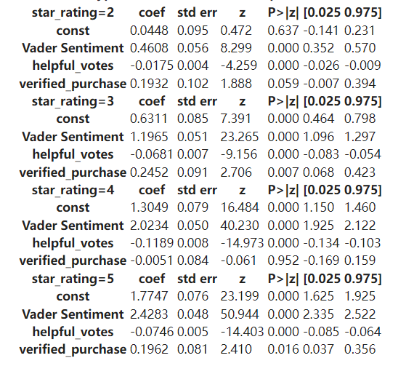
Multiple logistic regression
Multiple logistic regression with Vader sentiment analysis
The reference group is chosen to be "star_rating=1"
Increasing the polarity by one unit will result in an increase by 0.46 units in the log of the ratio between the probability of star_rating=2 vs. the probability of star_rating=1
Increasing the polarity score of reviews will significantly increase star rating
Notes:
mengting

Slide 17
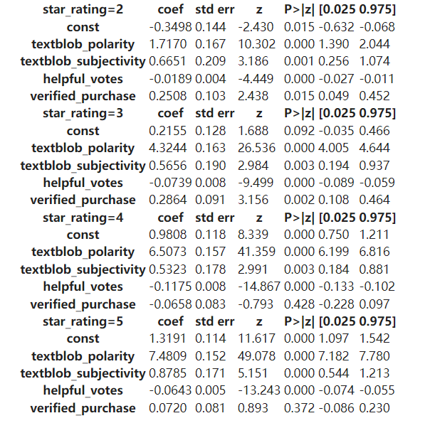
Multiple logistic regression
Multiple logistic regression with Text sentiment analysis
The reference group is chosen to be "star_rating=1"
Increasing the polarity by one unit will result in an increase by 1.72 units in the log of the ratio between the probability of star_rating=2 vs. the probability of star_rating=1
Increasing the polarity score of reviews will significantly increase star rating
Notes:
mengting

Slide 18
Predicting Review Ratings using Topic Probabilities and Embeddings
Research question:
Can topic probabilities and custom embeddings be used together to predict review rating category (positive, neutral, negative)?
Hypothesis:
The probability of each review containing each topic, along with embeddings to describe each review, will be strong predictors of review rating as evidenced by good model performance.

Slide 19
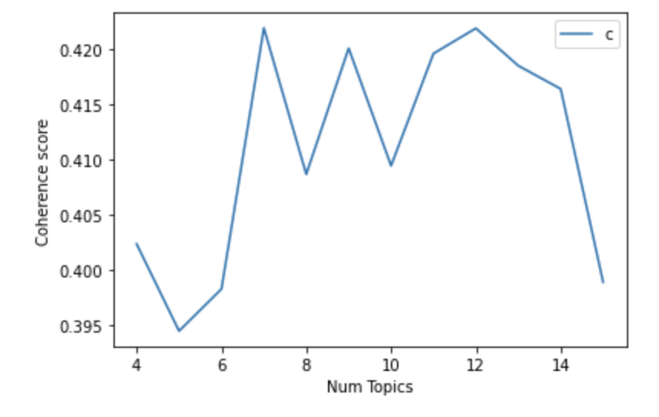
Creation of Topic Modeling and Embeddings
Review Body Topic Modeling
Custom Embeddings
LDA was used to determine common recurrent topics within the body of the reviews
Goal: find a balance of coherence score and topic interpretability
Tried various numbers of topics and token exclusion parameters
Best result was that of 7 topics, not considering any tokens that appeared in more than 75% of the reviews
Coherence score: 0.422
Trained 300-dimension custom embeddings based on the domain of the Amazon e-book reviews
Debated using pre-trained embeddings for product reviews embeddings but was not sure if it would be specific enough to e-books
Decided on 300-dimension embeddings to create lots of information about each review
Some of the top words associated with each topic:
Topic 1: kindle, easy, idea, use, work
Topic 2: character, novel, plot, interesting, action, mystery
Topic 3: story, love, romance, heart, character
Topic 4: book, one, would, think, know, time
Topic 5: life, people, child, world, god, history, time
Topic 6: family, year, man, woman, friend, mother
Topic 7: book, series, one, next, loved, wait, recommend

Slide 20
Using Topic Modeling and Embeddings
The combination of the topic probabilities and the embeddings created an alternative representation of every review
This representation could be used in classification modeling to predict the review rating category structured as:
307 Independent variables: topic probabilities generated by LDA for every topic for every review, along with the embeddings for every review composed
1 Dependent variable: review rating class: positive, neutral or negative
 | Probability of Topic 1 |  | Probability of Topic 7 | Embedding Dimension 1 |  | Embedding Dimension 300 | Review Rating Category
Review 1 | 0.1234 |  | 0.751 | 0.188 |  | 0.109 | positive
Review 2 | 0.456 |  | 0.345 | -0.002 |  | 0.546 | negative
Review 3 | 0.789 |  | 0.002 | 0.678 |  | -0.041 | neutral
Columns with probabilities of topics 2, 3, 4, 5, and 6
Columns with embedding dimensions 2-299

Slide 21
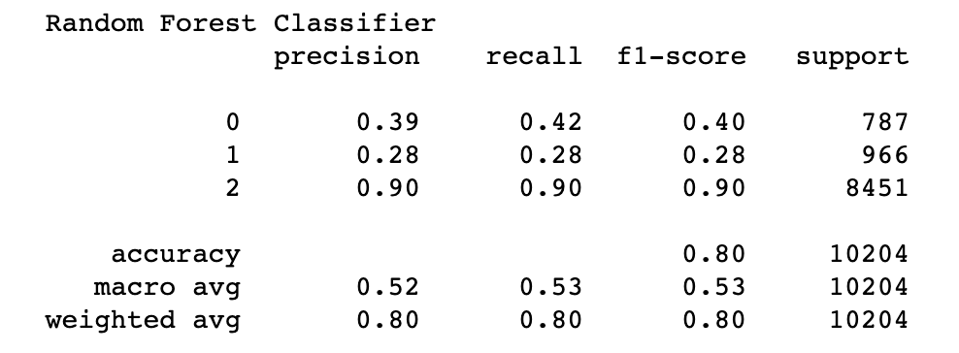
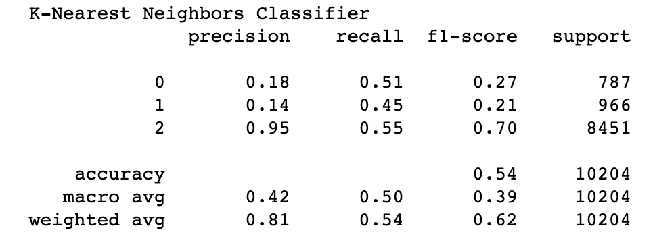
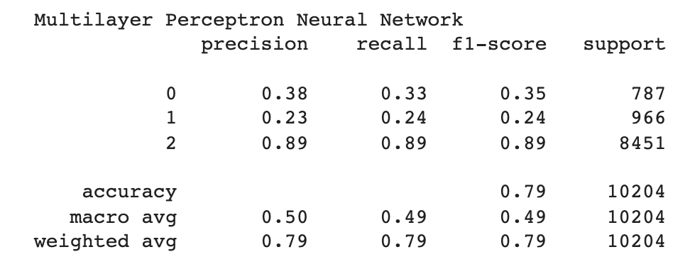
Classification using Topic Probabilities and Embeddings
Random Forest
KNN
Multilayer Perceptron Neural Network
Best Model Results
Training accuracy- 0.9401
Test accuracy- 0.8012
Test weighted-f1- 0.8023
Optimal Model Parameters:
class weight = balanced
max depth = none
estimators = 100
Best Model Results
Training accuracy- 0.8430
Test accuracy- 0.5387
Test weighted-f1- 0.6184
Optimal Model Parameters:
neighbors = 5
Best Model Results
Training accuracy- 0.9160
Test accuracy- 0.7876
Test weighted -f1- 0.7864
Optimal Model Parameters:
Hidden layers = 3 (first with 500 hidden nodes, second with 500, third with 100), relu activation
In the above, class 0 = negative reviews, class 1 = neutral reviews, class 2 = positive reviews
Notes:
GridsearchCV on all models to tune and cross validate

Slide 22
Book Genres Extraction and Correlation with Star Reviews
Research question:
Can we deduct meaningful genre categories from book titles and use them to assess whether specific book types are better rated?
Hypothesis:
There is a relationship between book genres and the star ratings they received. Not all book genres will have the same star review distribution.

Slide 23
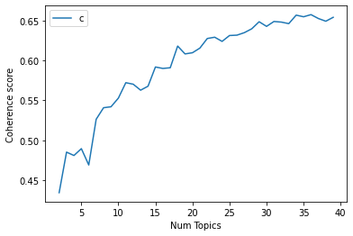
Topic Modeling based on Book Titles
Genre Topic Modeling
The book titles were used as the corpus
Goal: identify meaningful book genres based on the titles by maximizing coherence score while maintaining a manageable number of topics
Model was attempted using a number of models and text preprocessing techniques to maximize coherence scores
While coherence score could have been increased further, by about 0.3, the tradeoff would have involve more than doubling the number of topics.
Coherence score: 0.6182

Slide 24
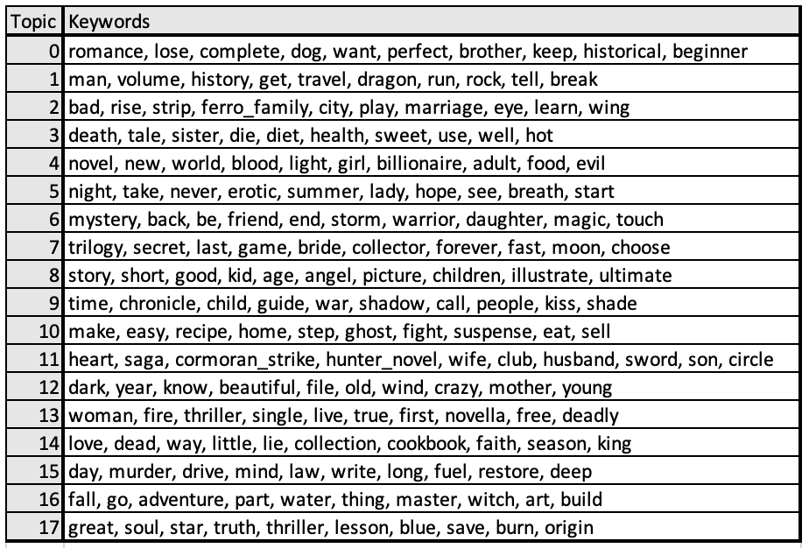
Genre Topics from Model

Slide 25
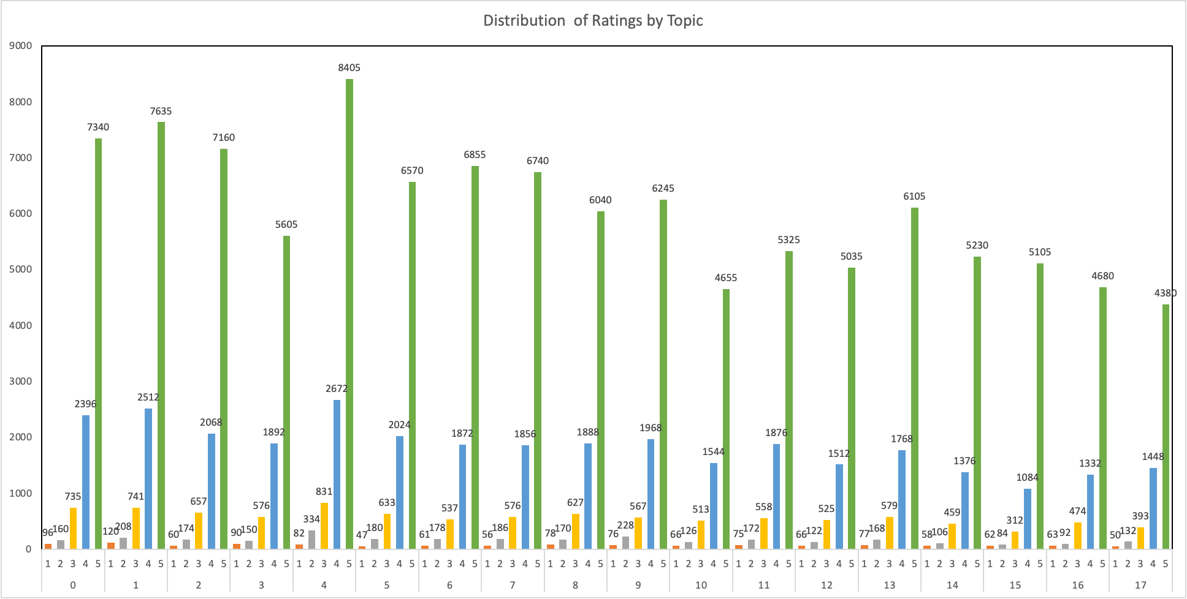
Distribution of Star Ratings by Topic

Slide 26
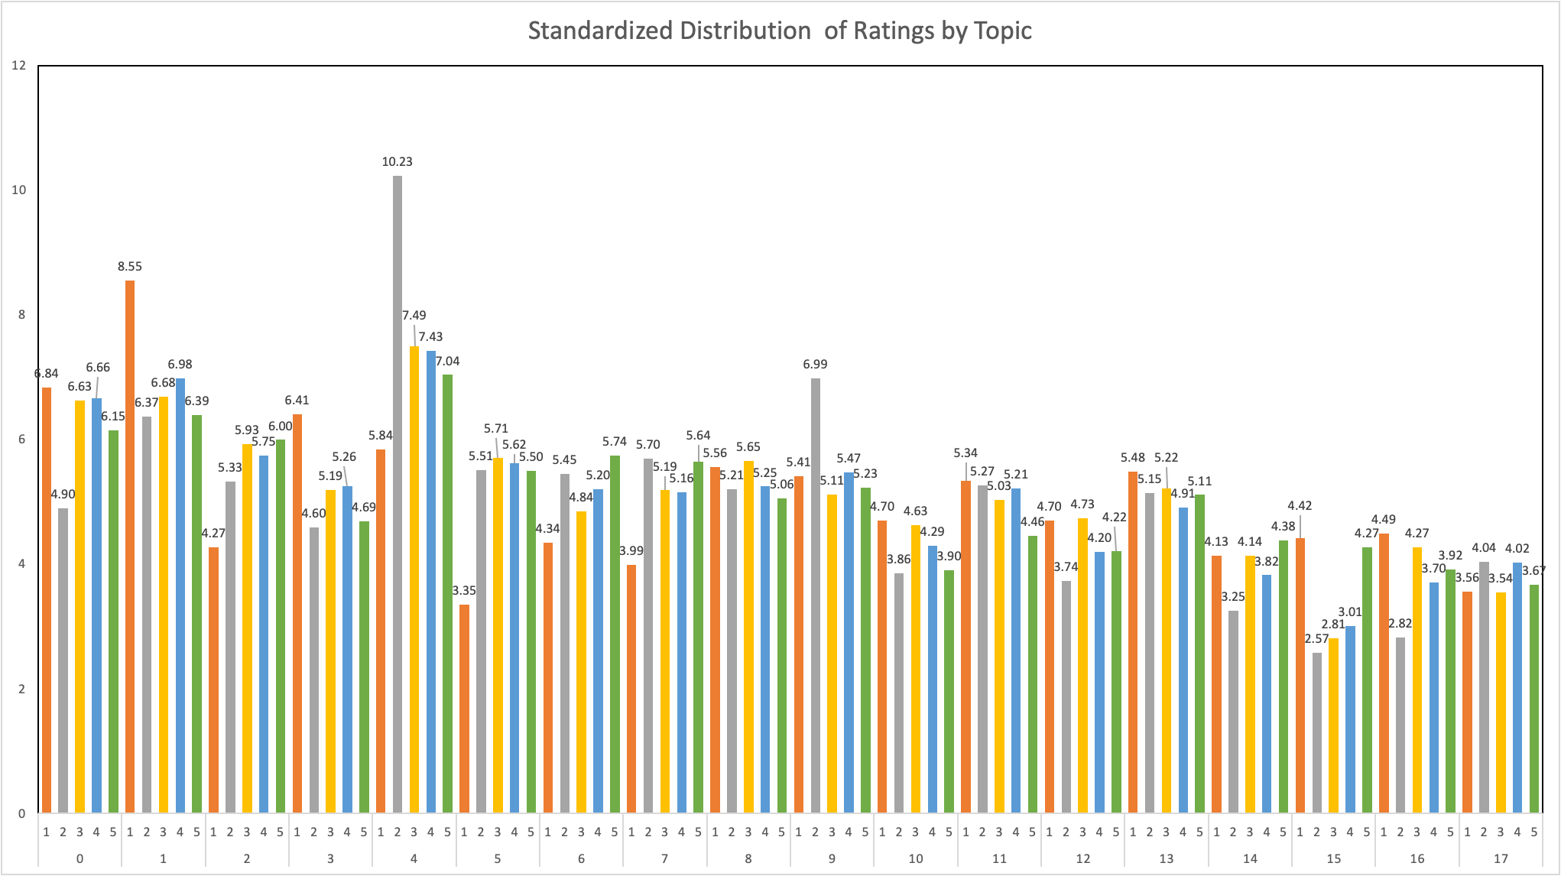
Standardized Distribution of Star Ratings by Topic

Slide 27
Conclusions
Based on our analysis, in response to our hypotheses, we conclude that:
The sentiment scores of reviews can be used to predict star ratings.
There is a positive relationship between polarity of reviews and star ratings.
The good performance of the classification models implies that using topic probabilities and embeddings as representations of each review are strong predictors of review rating category.
While the distribution of star ratings based on genre is slightly different, more text, like book synopsis would be a better fit in assessing the true relationship between genre ratings on Amazon.
Notes:
I just used the numbering of the hypotheses from slide 4 here, good wrap up

Slide 28
Thank You

Slide 29
Selected References
Van der Maaten, L., & Hinton, G. (2008). Visualizing Data Using t-SNE. Journal of Machine Learning Research
AlQahtani, A. S. (2021). Product Sentiment Analysis for Amazon Reviews. International Journal of Computer Science & Information Technology (IJCSIT) Vol, 13.
Hutto, C., & Gilbert, E. (2014, May). Vader: A parsimonious rule-based model for sentiment analysis of social media text. In Proceedings of the International AAAI Conference on Web and Social Media (Vol. 8, No. 1).

